Slide 1

Outlier Identification in Semi-Automated Bedrock Surface Dataset
Riley Balikian
Assistant Research Scientist
Illinois State Geological Survey
Prairie Research Institute
University of Illinois

Slide 2
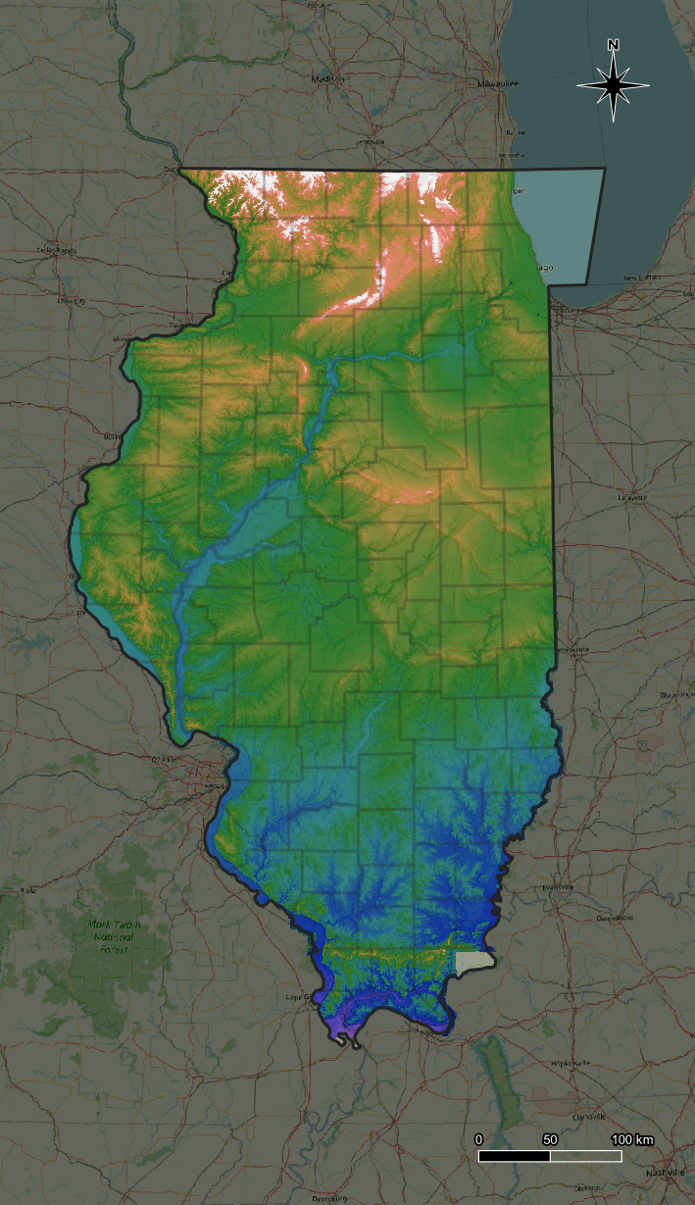
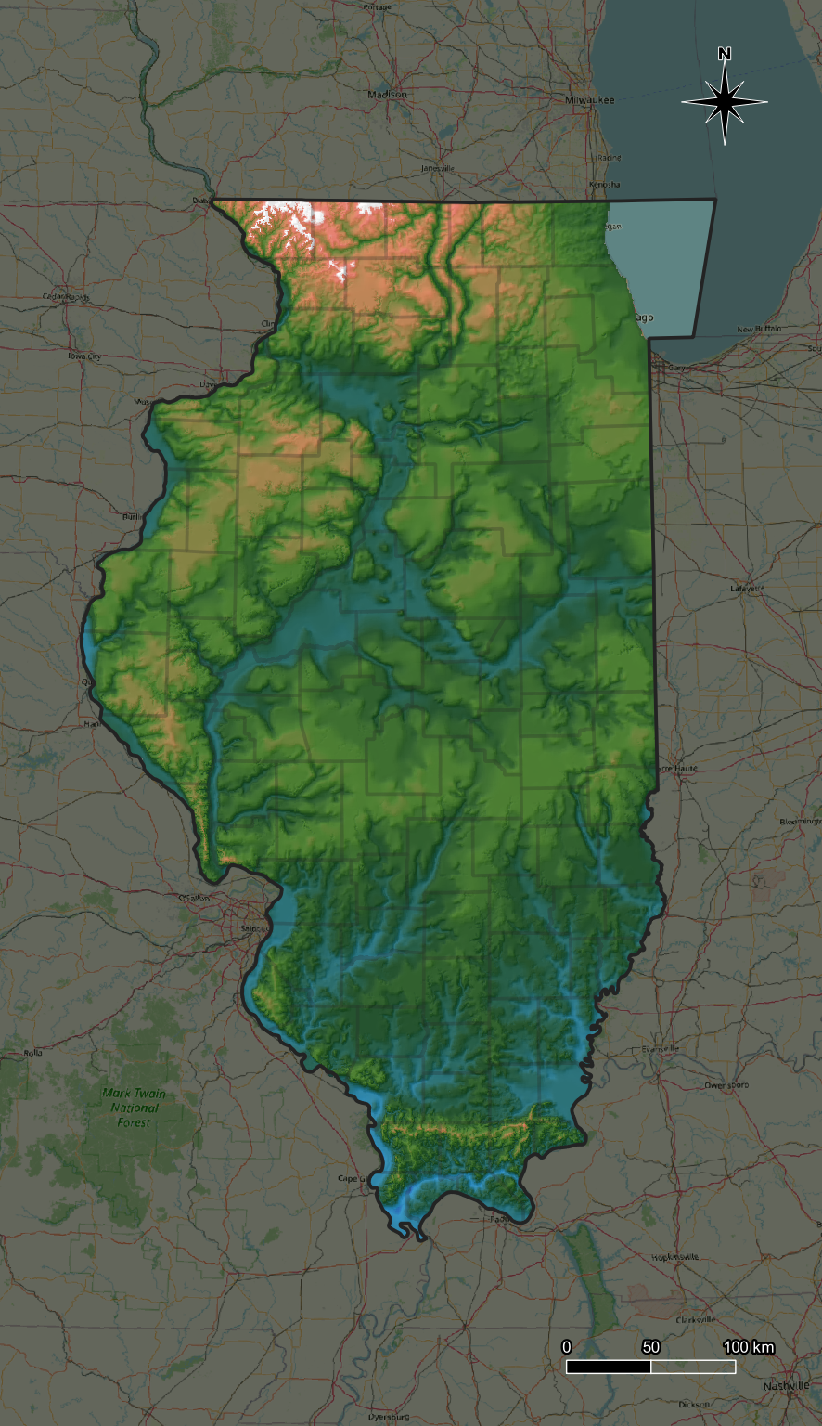
Surface Elevation
Bedrock Elevation

Slide 3
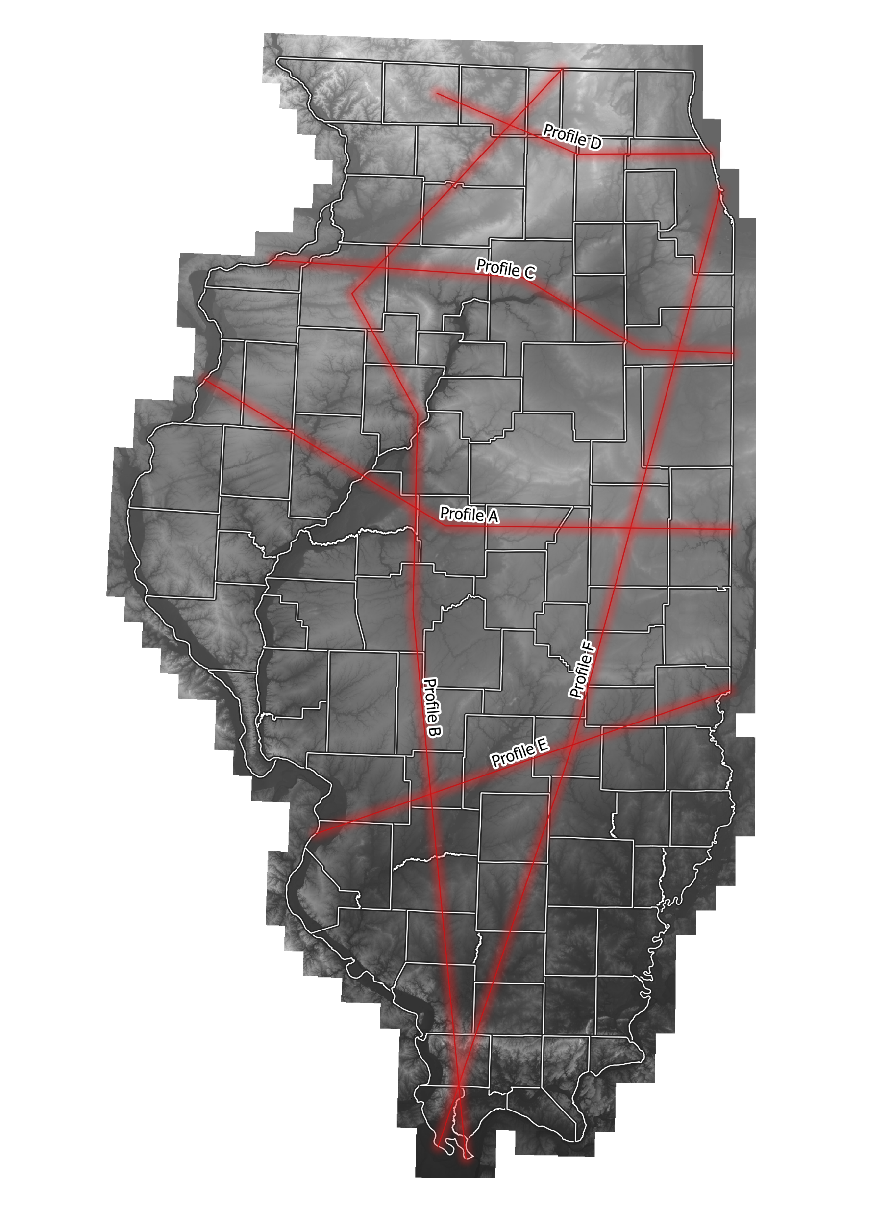
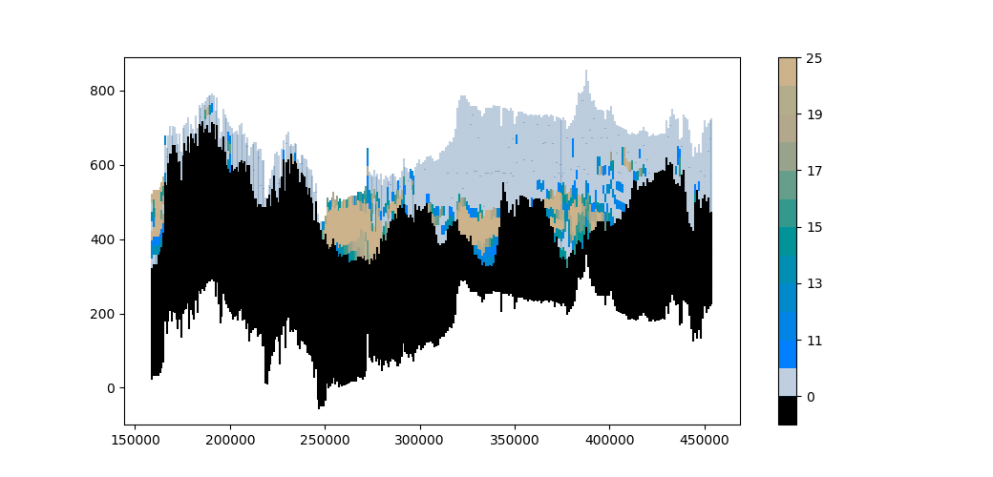

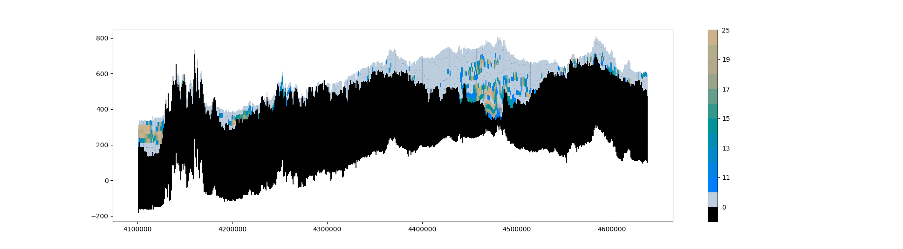
Why bedrock surface?
Vertical feet of “coarse” sediment in each 25’ x 1km cell
Profile A
F’
A
A’
Elevation (ft)
A
Peoria
Danville
Burlington
A’
Bedrock
UTM Easting
Profile F
F’
F
Chicago
Elevation (ft)
Cairo
Bedrock
F
UTM Northing
Subsurface was divided into 25’ depth intervals and 1 km length intervals to create these cross-section profiles

Slide 4
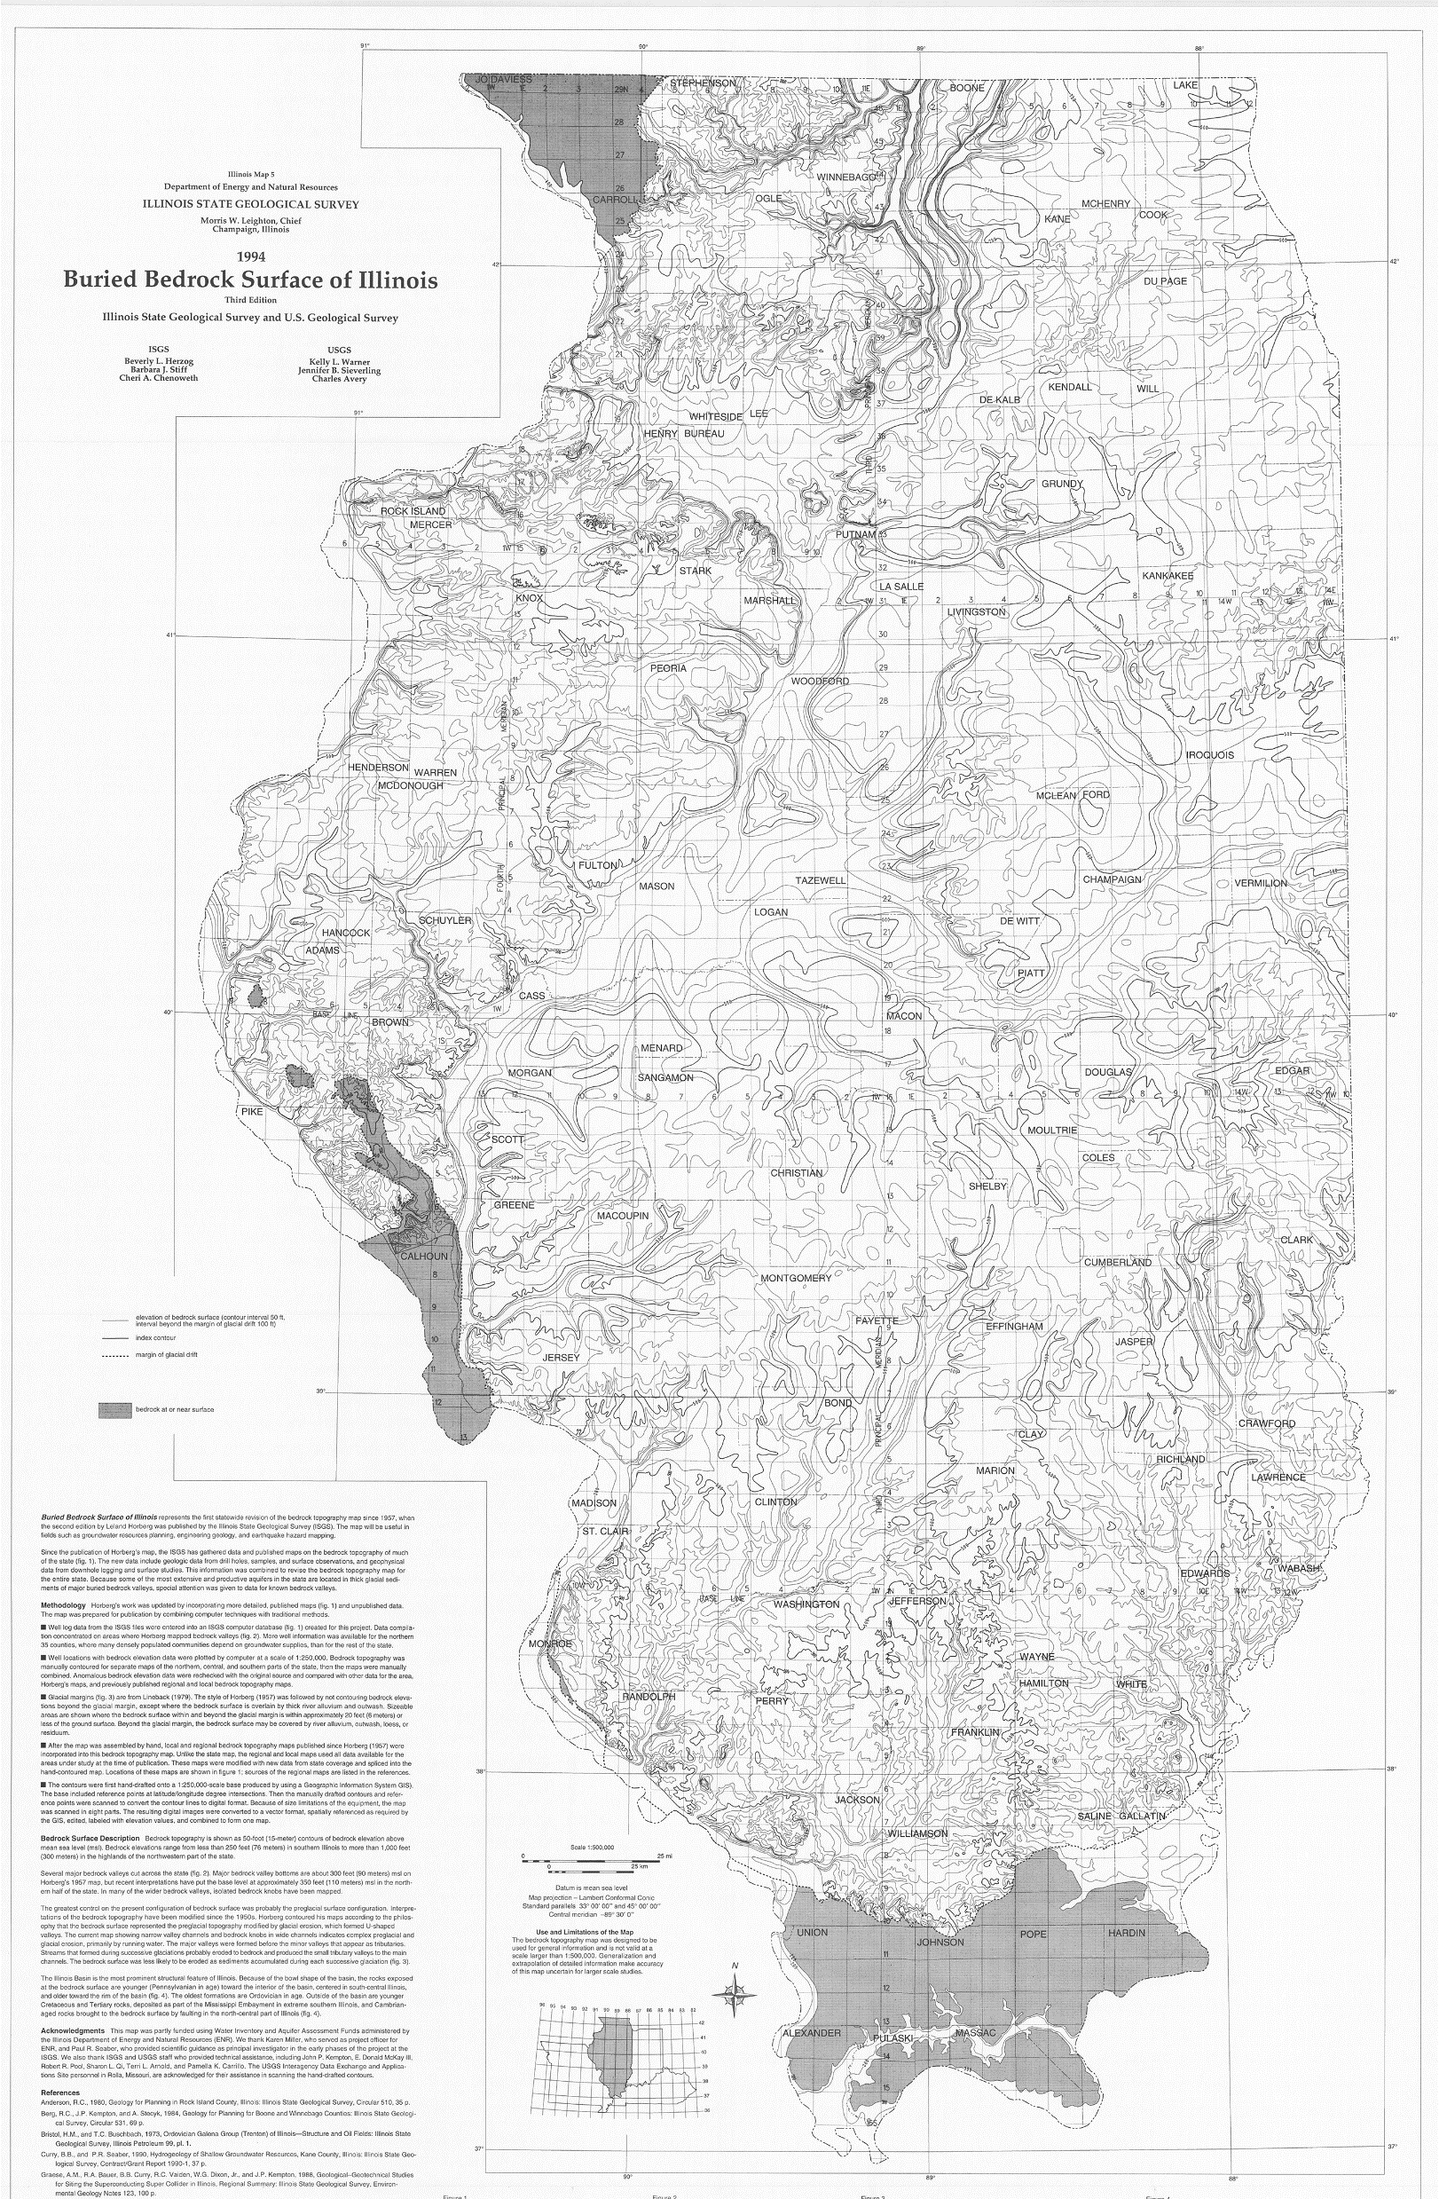
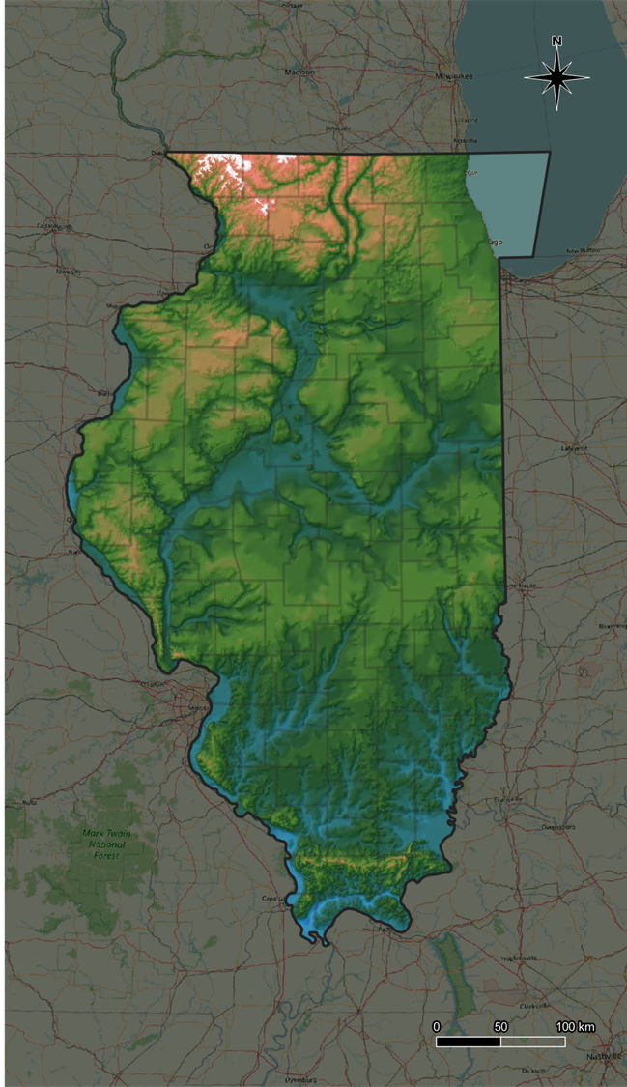

Slide 5
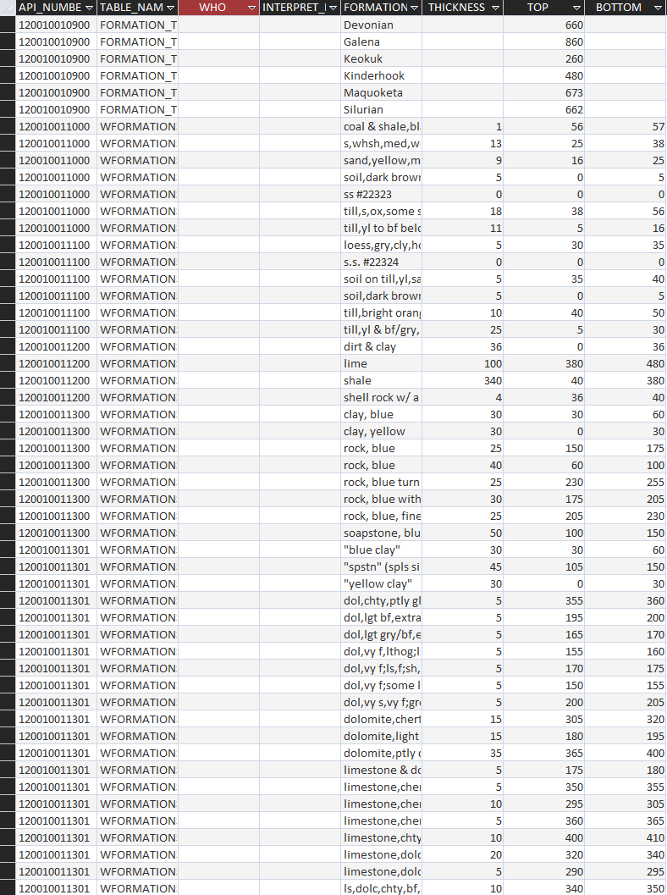
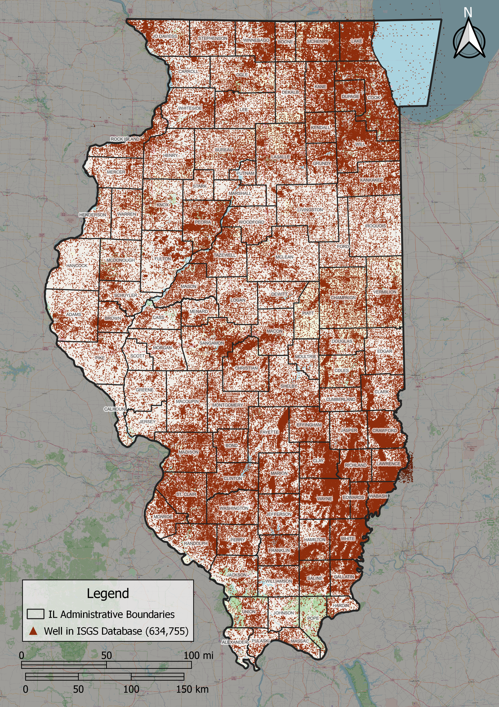
Well
12001001090
(6+ records/intervals)
Well
120010011000
(7 records/intervals)
Well
120010011100
(7 records/intervals)
Well
120010011300
(11 records/intervals)
More than ~635,000 unique wells
Over 3 million individual well records

Slide 6
Data Cleaning
Cleaning Steps:
Remove data with missing depths
Remove data with no locations
Remove data with no description
Remove data where top is below bottom
Remove data from outside state

Slide 7
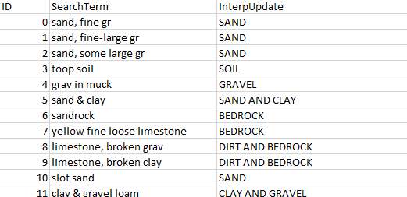
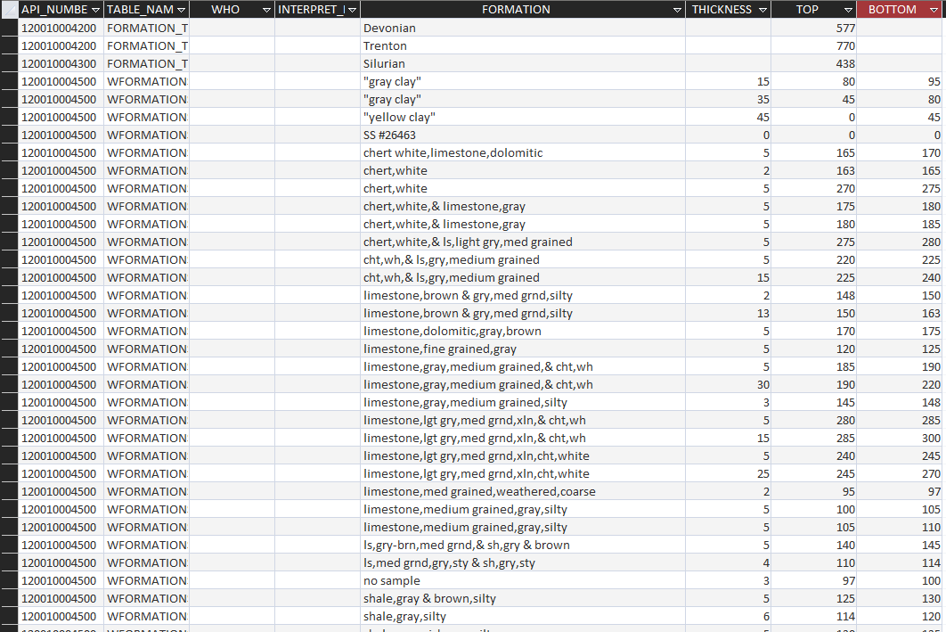
Data Classification
Exact Definitions

Slide 8
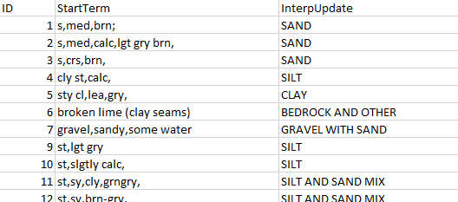
Data Classification
Exact Definitions
“Starts with…” Definitions (i.e., wildcard search: [searchterm]*)

Slide 9
Data Classification
Known Bedrock Depth (550’)
No bedrock valley in Illinois is deeper than 550’
All well records with a top depth > 550’ = bedrock

Slide 10
Bedrock Picking
Legend
First description is bedrock
Unclassified
Well A
Well B
Classified using “wildcard” start term
Well C
Well D
Well E
Classified using depth
Classified with an exact search term match

Slide 11
Bedrock Picking
Legend
First description is bedrock
Unclassified
Well A
Classified using “wildcard” start term
Classified using depth
Classified with an exact search term match

Slide 12
Bedrock Picking
Legend
First description is bedrock
Unclassified
Well A
Well B
Classified using “wildcard” start term
Classified using depth
Classified with an exact search term match

Slide 13
Bedrock Picking
Legend
First description is bedrock
Unclassified
Well A
Well B
Classified using “wildcard” start term
Well C
Classified using depth
Classified with an exact search term match

Slide 14
Bedrock Picking
Legend
First description is bedrock
Unclassified
Well A
Well B
Classified using “wildcard” start term
Well C
Well D
Classified using depth
Classified with an exact search term match

Slide 15
Bedrock Picking
Legend
First description is bedrock
Unclassified
Well A
Well B
Classified using “wildcard” start term
Well C
Well D
Well E
Classified using depth
Classified with an exact search term match

Slide 16
Bedrock Picking
Legend
First description is bedrock
Unclassified
Well A
Well B
Classified using “wildcard” start term
Well C
Well D
Well E
2
1
Classified using depth
0
-1
-2
Classified with an exact search term match

Slide 17
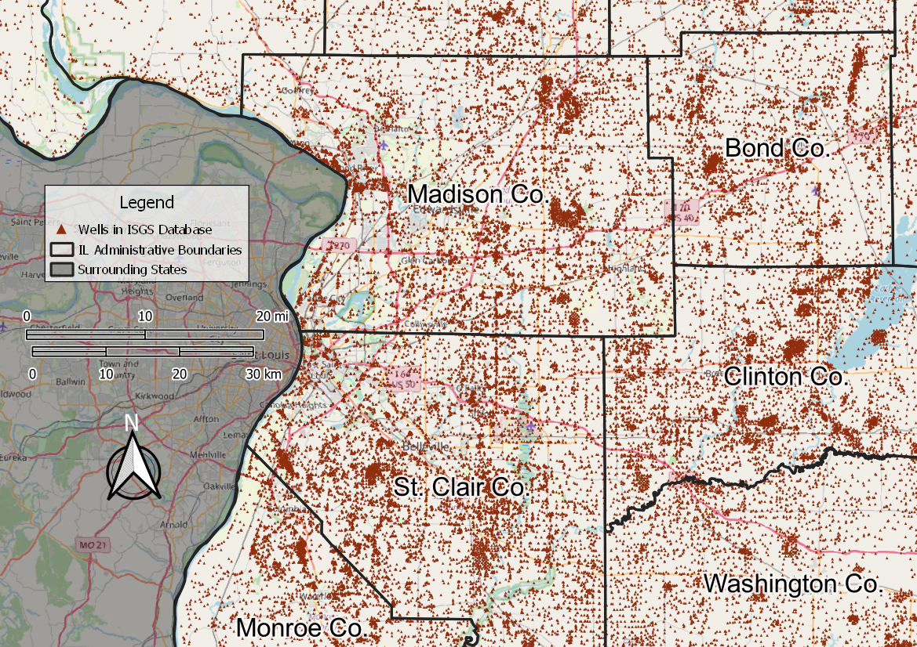
Unsupervised classification of well logs
Well Database Tables
Geologist Descriptions
Driller Descriptions
Engineer Descriptions
Well Metadata
Classify Descriptions
Map & Extract Elevation
Exact Definitions | Wildcard Search
Join data
Boolean flag for bedrock data
Flag Bedrock Well Intervals
Shallowest interval flagged as bedrock in each well
Wells w/o location info
Records w/o depth info
Records w/bad info (eg, top below bottom)
Removed
3,651 wells
415,337 records
Pick 1st Bedrock Interval
Clean Data
All data above rock classified
Certainty of classification
Records start at surface
Classify bedrock pick quality
Export
Notes:
Many wells
Not evenly distributed
Locations possibly questionable
635K wells in db

Slide 18
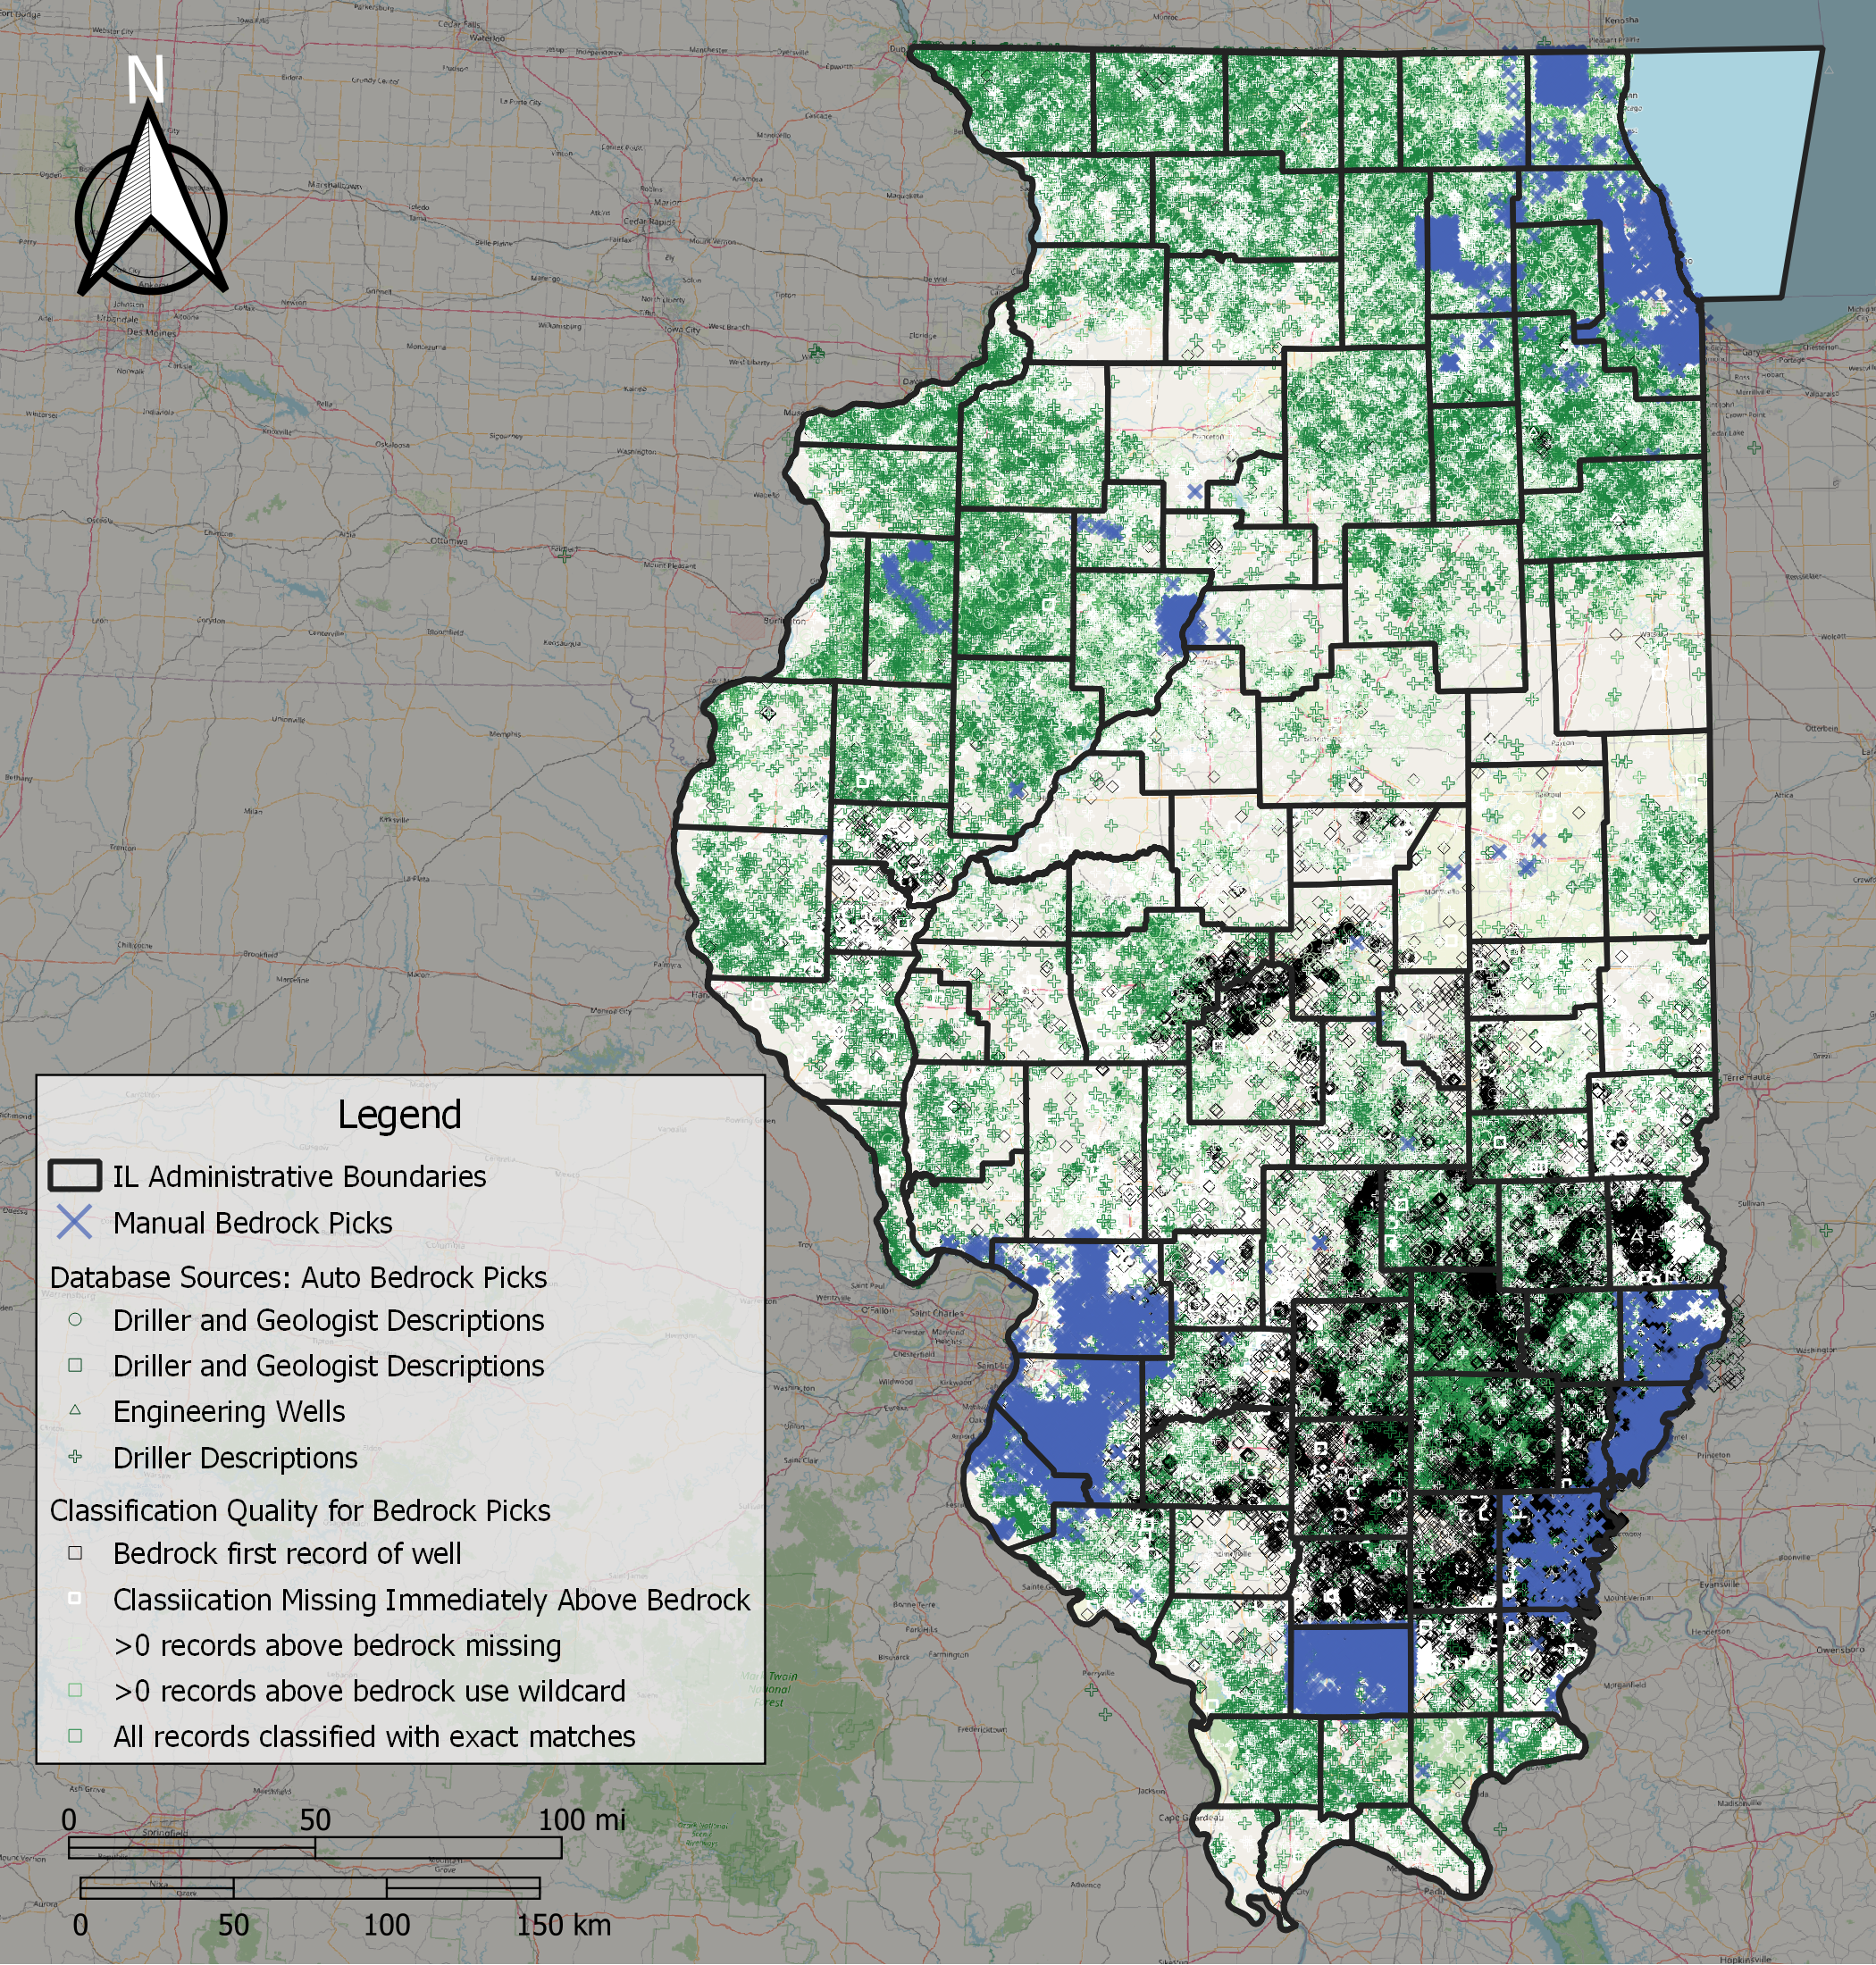

Slide 19
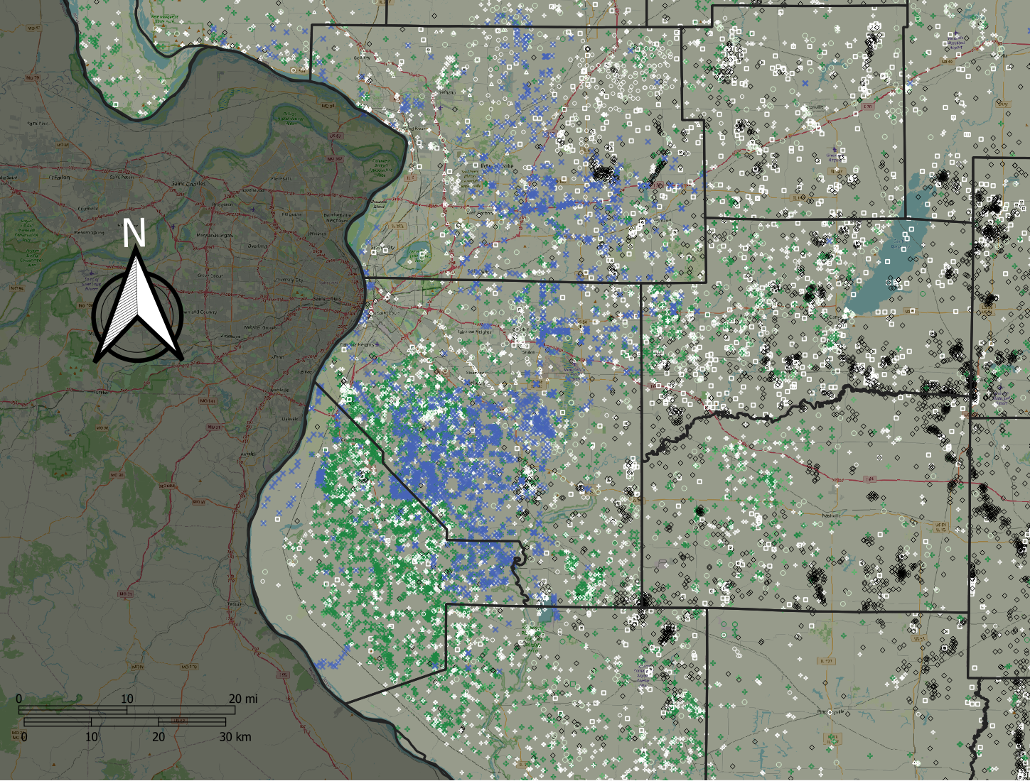
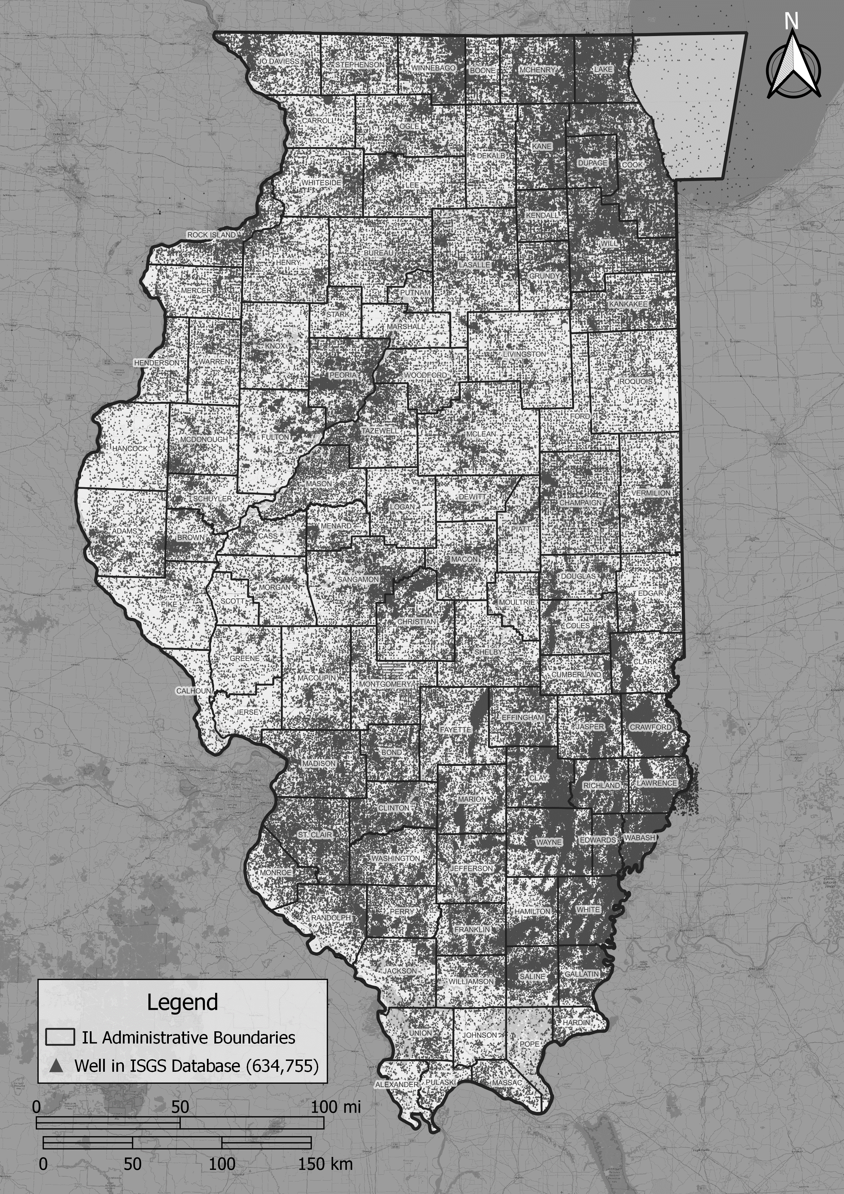
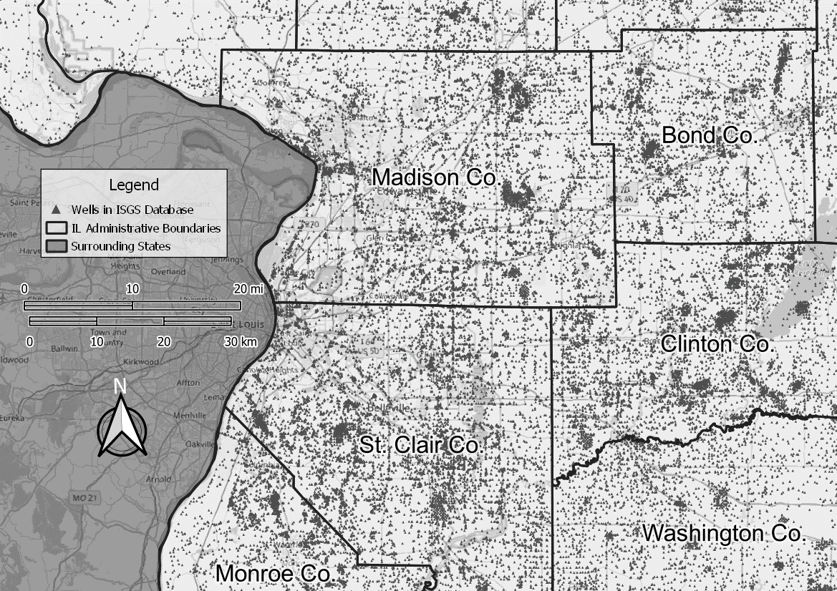
Unsupervised classification of well logs
Notes:
Blue – Picks
Green – Pass the tests
Black – bad
White – Sparse because many did not pass.

Slide 20
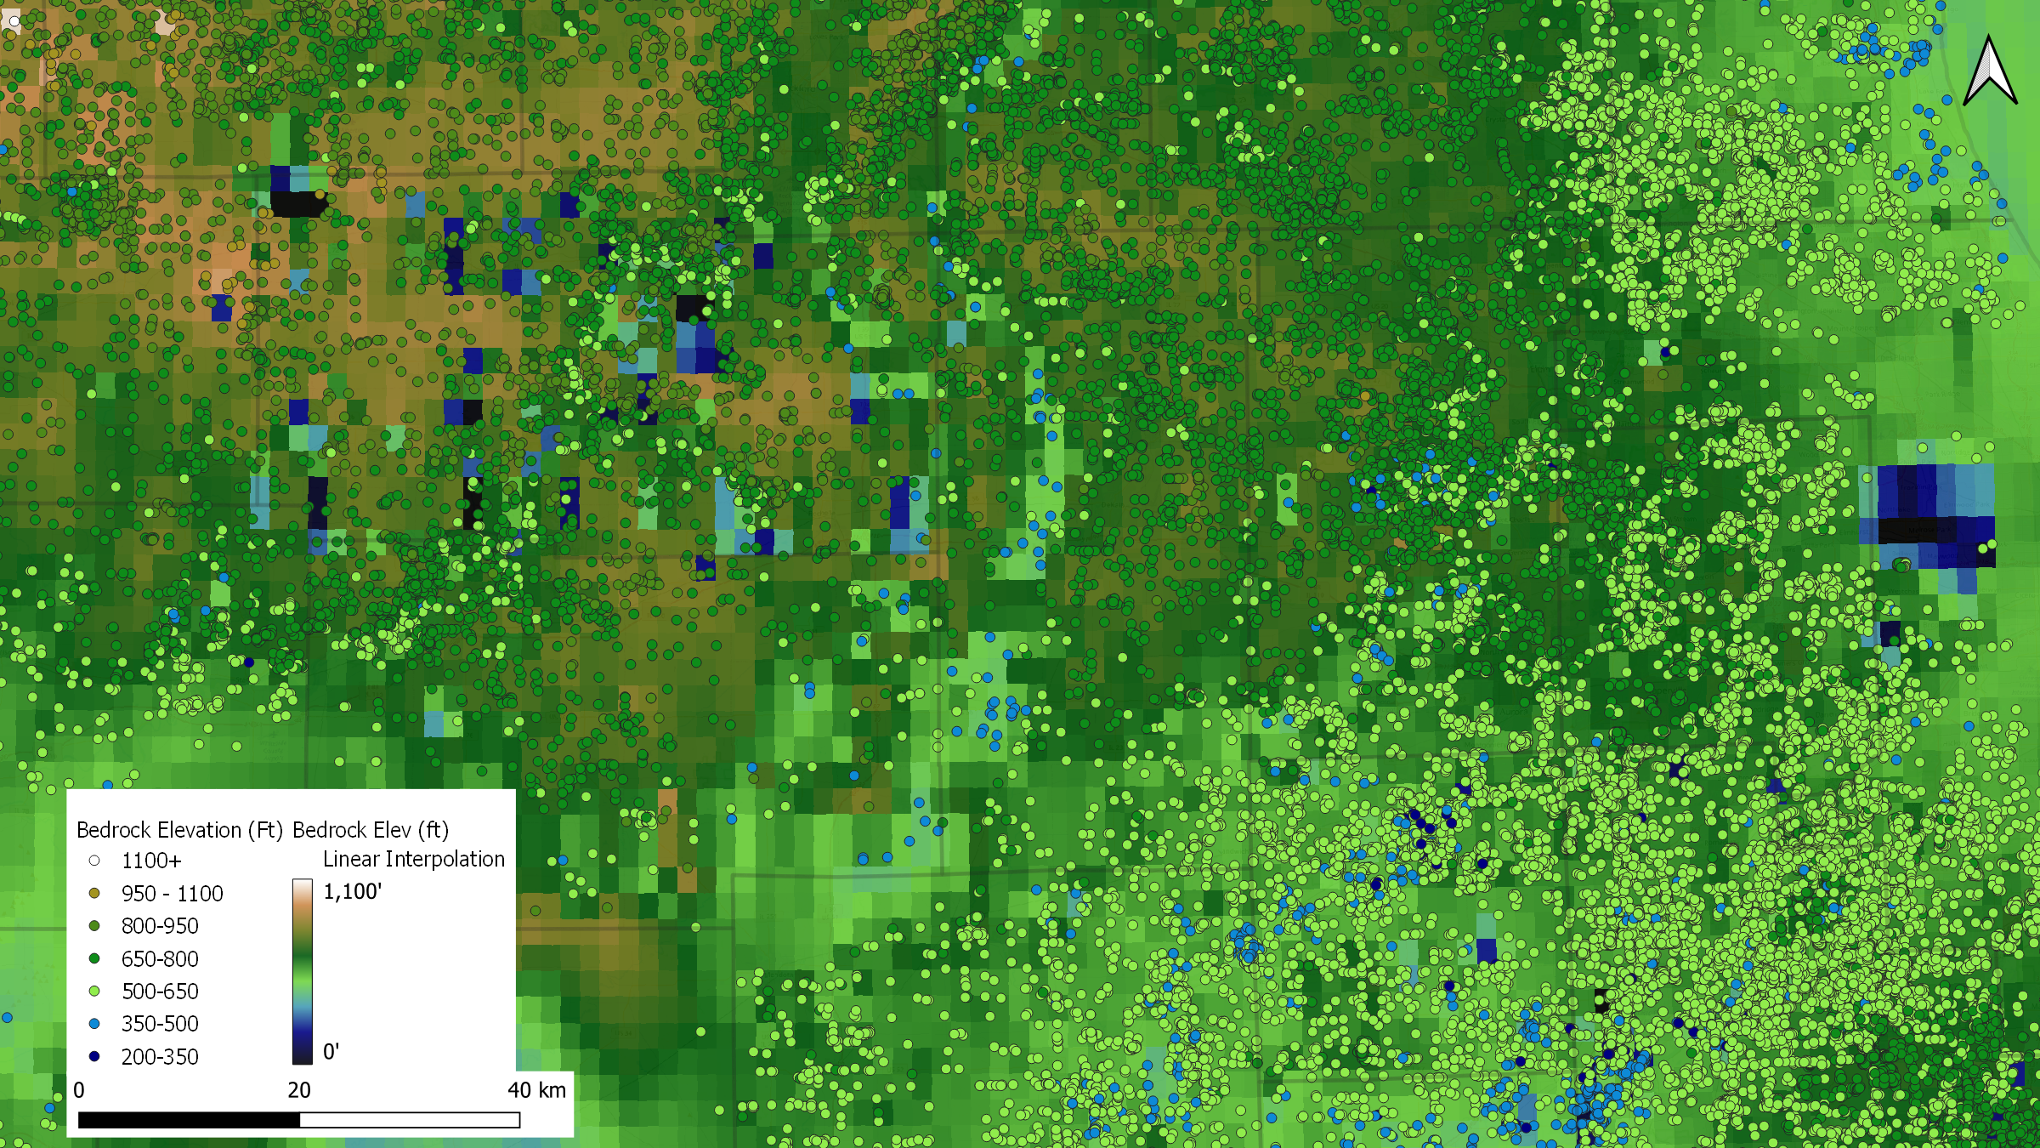

Slide 21
Statistics Consulting Needs:
From the output
How to identify “outliers”?
Variable surface texture
Can the weightings/pick classifications be used to help with this?
The source tables may be of help with weighting too
In the workflow:
Other methods for identifying poor descriptions?
Other methods for classification or weighting of well records?
Other methods for classification or weighting of bedrock?
Other suggestions?
Main question

